Slide 1
Introduction to Linux
Chapter 1

Slide 2
Objectives
After completing this chapter, you will be able to:
Explain the purpose of an operating system
Outline the key features of the Linux operating system
Describe the origins of the Linux operating systems
Identify the characteristics of various Linux distributions and where to find them
Explain the common uses of Linux in industry today

Slide 3
Operating Systems (1 of 7)
Computers have two fundamental components
Hardware: physical components inside a computer
Software: set of instructions or programs that allow hardware components to manipulate data

Slide 4
Operating Systems (2 of 7)
Hardware components
Processor (CPU)
Physical memory (RAM)
Hard disk and solid state drives
CD and DVD drives
Flash memory card readers (SD cards)
Sound cards
Video cards
Network adapter cards
Ports
Mainboards (motherboards)

Slide 5
Operating Systems (3 of 7)
Two types of programs are executed on a computer
Applications (apps): programs designed for a specific use and with which a user interacts
Operating system (OS) software: software components used to control the hardware of the computer

Slide 6
Operating Systems (4 of 7)
Device driver: software containing instructions that the OS uses to control and interact with a specific device
User interface: application program that accepts user input indicating what to do, forwards this input to the OS for completion, and gives results back to the user
Can be a command line prompt or a graphical user interface (GUI)

Slide 7
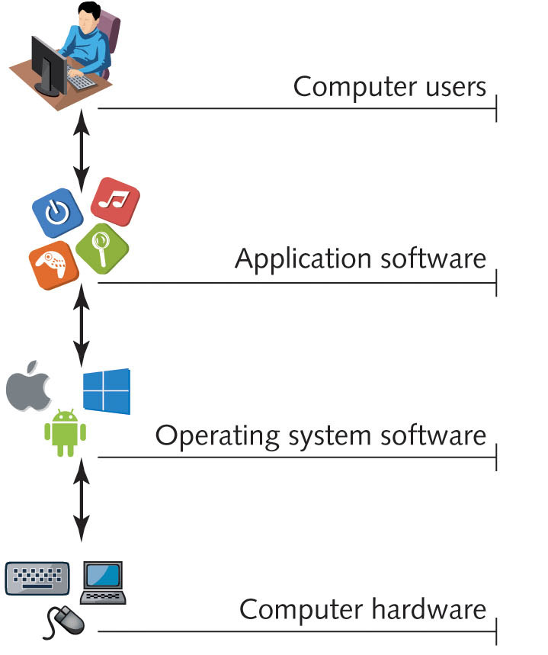
Operating Systems (5 of 7)
Figure 1-1: The role of operating system software.

Slide 8
Operating Systems (6 of 7)
Graphical user interface (GUI): component of an OS that the user can interact with using the keyboard or the mouse
Consists of menus, dialog boxes, and symbols (known as icons)
System services: applications that handle system-related tasks
Printing
Scheduling programs
Gaining network access

Slide 9
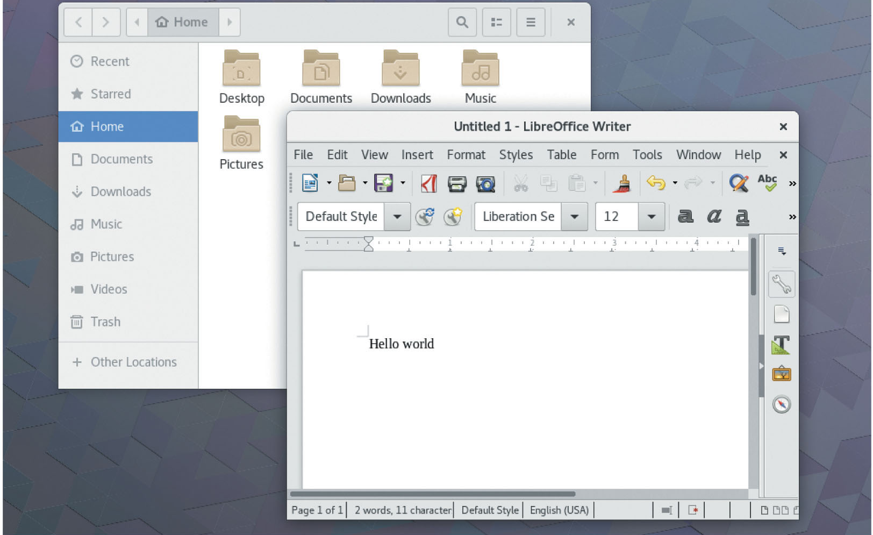
Operating Systems (7 of 7)
Figure 1-2: A Linux graphical user interface.
Source: Red Hat, Inc.

Slide 10
The Linux Operating System
Linux: OS used to run a variety of applications on a variety of different hardware components
Multiuser and multitasking OS
Ability to manage thousands of tasks at the same time
Allows multiple users to access the system simultaneously

Slide 11
Versions of the Linux Operating System
Linux kernel: core component
Written almost entirely in the C programming language
Software can be used to modify appearance of Linux, but the kernel is common to all Linux
Important to understand Linux kernel version numbers to decide which version is appropriate
Good understanding of system hardware is important in deciding which kernel version to use

Slide 12
Identifying Kernel Versions
Linux kernel versions components
Major number: indicates major revision to Linux kernel
Minor number: indicates minor revision and stability of Linux kernel
Production kernel: kernel that has been thoroughly tested and is declared to be stable
Developmental kernel: kernel which is not fully tested and with implied instability
Revision number: most current changes to the version

Slide 13
Licensing Linux (1 of 3)
Open Source Software (OSS)
Freely developed and continuously improved by a large community of software developers
Source code
List of instructions that a software developer writes to make up a program
Format and structure of source code follows rules defined by the programming language in which it was written

Slide 14
Licensing Linux (2 of 3)
Implications of OSS software development
Software is developed very rapidly through widespread collaboration
Software bugs (errors) are noted and promptly fixed
Software features evolve quickly based on users’ needs
The perceived value of the software increases because it is based on usefulness, not on price

Slide 15
Licensing Linux (3 of 3)
Table 1-2 Software types
Type | Description
Open source | Software in which the source code and software can be obtained free of charge and optionally modified to suit a particular need
Closed source | Software in which the source code is not available; although this type of software might be distributed free of charge, it is usually quite costly and commonly referred to as commercial software
Freeware | Closed source software that is given out free of charge; it is sometimes referred to as freemium software
Shareware | Closed source software that is initially given out free of charge but that requires payment after a certain period of use

Slide 16
Types of Open Source Licenses
GNU Public License (GPL)
Developed by the Free Software Foundation (FSF)
Stipulates that the source code of any software published under its license must be freely available
Users who modify the source code must also redistribute the modified code freely
Artistic license: ensures source code is freely available
Original author has some control over changes

Slide 17
Types of Closed Source Licenses
Most closed source software is sold commercially
Usually bears label of manufacturer
Freeware
Distributed free of charge; source code is not available
Shareware
Initially free, but requires payment after a period of time or for use of certain features

Slide 18
Linux Advantages (1 of 7)
Risk reduction
Changes in the market or customer needs may cause companies to change software frequently
Can be costly and time-consuming
Support for closed source software may end
Vendor may go out of business
Software version may be retired
OSS products offer the opportunity to maintain and change the source code

Slide 19
Linux Advantages (2 of 7)
Meeting business needs
Common software available for Linux
Scientific and engineering software
Software emulators
Web servers, Web browsers, and e-commerce suites
Desktop productivity software
Graphics manipulation software
Database software
Security software

Slide 20
Linux Advantages (3 of 7)
Stability and security
Customers using a closed source OS must rely on the vendor to fix any bugs
Waiting for a hot fix may take weeks or months
The collaborative open source approach to testing and fixing bugs increases the stability of Linux
Bugs and security loopholes in OSS programs can be identified and fixed quickly
Code is freely available and scrutinized by many developers

Slide 21
Linux Advantages (4 of 7)
Flexibility for different hardware platforms
Partial list of hardware platforms on which Linux can run
Intel x86/x64 and Itanium
PA-RISC and Mainframe (S/390, z/Architecture)
ARM and MIPS
SPARC/Ultra-SPARC
PowerPC/POWER
Ease of customization
Ability to control the inner workings of the OS
Can choose to install only software packages needed
Linux supports several programming languages, such as shell and PERL scripts to customize or automate tasks

Slide 22
Linux Advantages (5 of 7)
Ease of obtaining support
Linux documentation found on the Internet
Frequently asked questions (FAQs)
HOWTO documents: maintained by authors but centrally collected by the Linux Documentation Project (LDP)
Internet newsgroups
Linux User Groups (LUGs): open forum of Linux users who discuss Linux-related issues and problems

Slide 23
Linux Advantages (6 of 7)
Cost reduction
Linux is less expensive than other OSs
No cost associated with acquiring the software
A wealth of OSS can run on a variety of different hardware platforms running Linux
Largest costs associated with Linux are costs associated with hiring people to maintain the system
Total cost of ownership (TCO): overall cost of using a particular OS

Slide 24
Linux Advantages (7 of 7)
Table 1-3: Calculating the total cost of ownership
Costs | Linux | Closed source operating system
Operating system cost | $0 | Greater than $0
Cost of administration | Low: Stability is high and bugs are fixed quickly by open source developers. | Moderate/high: Bug fixes are created by the vendor of the operating system, which could result in costly downtime.
Cost of additional software | Low/none: Most software available for Linux is also open source. | Moderate/high: Most software available for closed source operating systems is also closed source.
Cost of software upgrades | Low/none | Moderate/high: Closed source software is eventually retired, and companies must buy upgrades or new products to gain functionality and stay competitive.

Slide 25
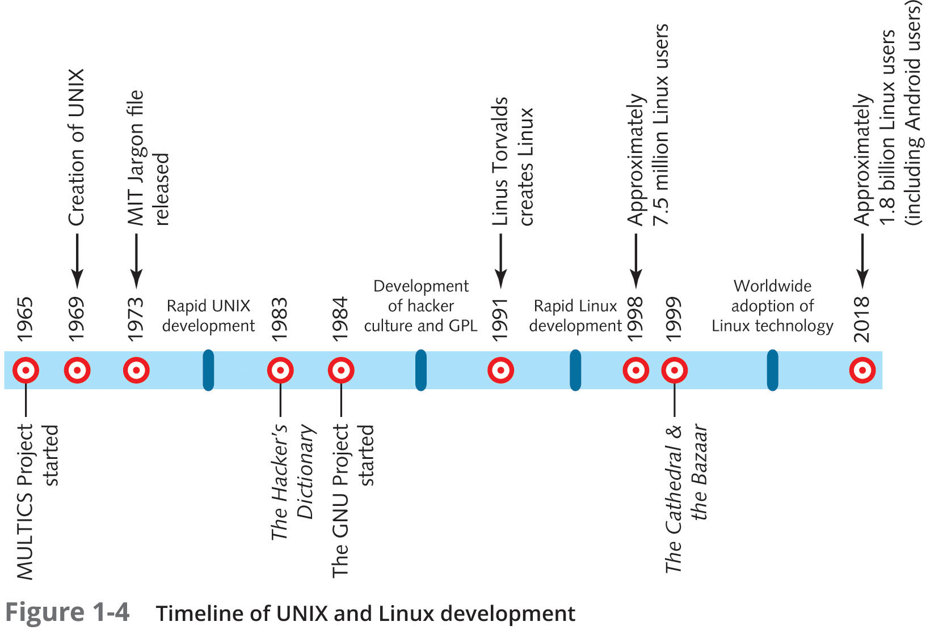
The History of Linux
Figure 1-4: Timeline of UNIX and Linux development.

Slide 26
UNIX (1 of 2)
Evolved from Multiplexed Information and Computing Service (MULTICS)
Project was abandoned
Rewritten in the C programming language
Able to run on different hardware platforms
AT&T sold UNIX source code to several companies
Each developed its own variety, or flavor, of UNIX yet adhered to standards agreed upon by all

Slide 27
UNIX (2 of 2)
Berkeley Software Distribution (BSD)
Version of the original UNIX source code
Common flavors of UNIX today
BSD
Hewlett-Packard’s HP-UX
IBM’s AIX
Apple’s macOS and iOS operating systems

Slide 28
The Hacker Culture (1 of 2)
Hacker: a person who attempts to expand knowledge of computing through experimentation
Cracker: someone who illegally uses computers for personal benefit or to cause damage
Richard Stallman: famous hacker who worked at MIT
Formed the Free Software Foundation (FSF)
Encouraged free software development

Slide 29
The Hacker Culture (2 of 2)
GNU project by Richard Stallman
Promoted free development for a free OS that was not UNIX
GNU project led to publication of GNU Public License (GPL)
Legalized free distribution of source code and encouraged collaborative development
This hacker culture of collaborative development set the stage for Linux

Slide 30
Linux (1 of 2)
First developed by Linus Torvalds in 1991
Published under the GNU license
Linux kernel was developed collaboratively and centrally managed
Hackers developed Linux add-on packages and distributions
Distribution: collection of software containing Linux kernel and libraries, combined with add-on software
Red Hat and OpenSUSE
Debian and Ubuntu
Gentoo, Linux Mint, and Arch

Slide 31
Linux (2 of 2)
Linux is a by-product of OSS development
Changed over time
Since 2000, there has been interest in embedded Linux
Linux OSs that run on smaller hardware devices such as mobile devices
Linux is currently very well developed
More application development can be expected from the OSS community in the next decade

Slide 32
Linux Distributions (1 of 5)
Varied distributions of Linux are essentially the same under the surface
Do have important differences
Some distributions include a large number of server-related tools
Web servers
Database servers
Most distributions include a GUI that can be further customized to suit the needs of the user
Core component of this GUI is X Windows

Slide 33
Linux Distributions (2 of 5)
GUI environment
X Windows in combination with a window manager and desktop environment
Two competing GUI environments in Linux
GNU Object Model Environment (GNOME)
K Desktop Environment (KDE)

Slide 34
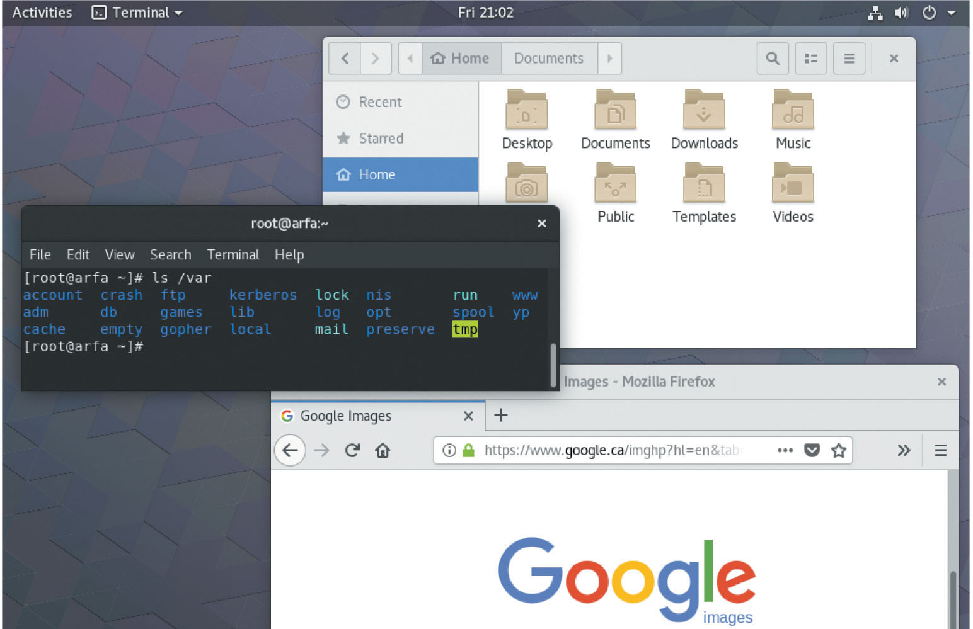
Linux Distributions (3 of 5)
Figure 1-5: The GNOME Desktop

Slide 35
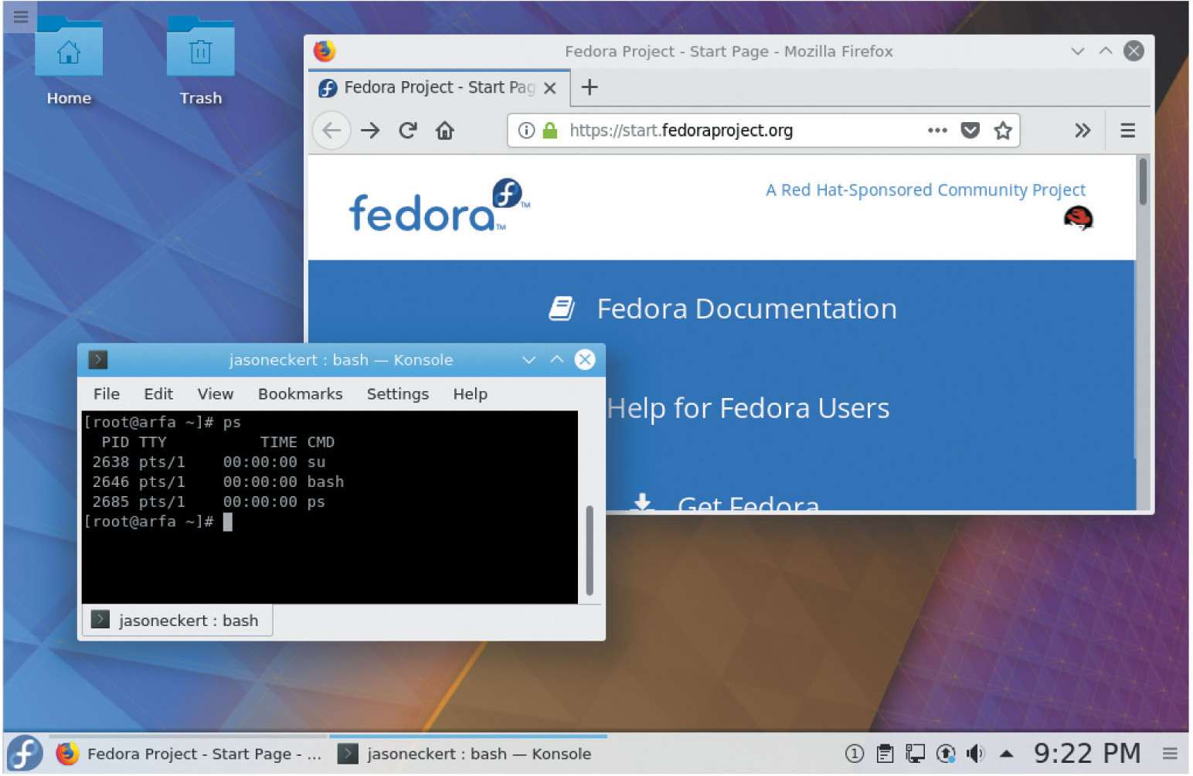
Linux Distributions (4 of 5)
Figure 1-6: The KDE Desktop
Source: Red hat, Inc

Slide 36
Linux Distributions (5 of 5)
Package manager: software system that installs and maintains software
Red Hat Package Manager: most widely supported package manager
Tarball: compressed archive of files containing scripts that install software to the correct location on the system
Difficult to manage, upgrade, or remove from system

Slide 37
Common Uses of Linux (1 of 2)
Linux may be customized to provide services for a variety of companies in a variety of situations
Workstation services: services used on a local computer
Server services: services made available for other computers across a network

Slide 38
Common Uses of Linux (2 of 2)
Linux configurations commonly used today
Internet servers
File and print servers
Application servers
Cloud systems
Supercomputers
Scientific workstations
Office/personal workstations
Mobile devices

Slide 39
Internet Servers
Most common Internet services
Web services
DNS and DHCP services
Time services
Mail services
FTP services
Authentication services
Certificate services
Routing services
Firewall and proxy services
Advanced security services

Slide 40
File and Print Servers
Linux is well-suited for centrally sharing resources
More economical to share files and printers over a network
Inherently fast and light OS
A distribution specific to a certain task can be installed on the central server
Can share resources with a computer running another OS
Most common service used to allow clients to connect to shared information and printers on a Linux server is Samba

Slide 41
Application Servers
Application server: intermediary between a client computer and information, normally stored in a database
Database: organized collection of data that is arranged into tables of related information
Database Management Systems (DBMSs): programs designed to allow for creation, modification, manipulation, maintenance, and access of information from databases
Application servers can provide management functionality

Slide 42
Cloud Systems
Cloud is just another term for the Internet
Organizations are moving their data to servers that are hosted within data centers accessible across the Internet
Cloud servers offer the advantage of accessing their data from anywhere
Private cloud
Cloud provider
Main approaches to hosting data and services within the cloud
Software as a Service (SaaS)
Platform as a Service (PaaS)
Infrastructure as a Service (IaaS)

Slide 43
Supercomputers
Clustering: combining several smaller computers to act as one large supercomputer
Beowulf clustering: most common Linux method of clustering
Message Passing Interface (MPI): used on Beowulf clusters to pass information to separate computers
Scalability: ability for a computer to increase workload as the number of processors increases
Clustering computers often results in better scalability

Slide 44
Scientific/Engineering Workstation
Scientific and engineering community often needs customized programs
OSS programs can be used or modified to create specific scientific and engineering fields
Many OSS programs are available

Slide 45
Office/Personal Workstation
Workstation software designed for end users in office and home environments
Allow the user to create, organize, and manipulate office documents and graphic art
Several OSS packages available
Graphics editing software (Gimp)
Desktop publishing software (Scribus)
Media software (VLC)
Financial software (Gnucash)
Office productivity suites (Apache OpenOffice)
Bittorrent clients (qBitTorrent)

Slide 46
Cybersecurity Workstations
Technologies and processes used to analyze existing security and provide data protections
Vulnerability assessments
Penetration tests
Security monitoring
Most tools for performing a vulnerability assessment and penetration test, as well as the tools for detecting and investigating security breaches are exclusively for Linux systems

Slide 47
Mobile Devices
Following Apple iPhone introduction in 2007 several Linux-based smartphone and tablets appeared
Google Android in 2008 is most notable
By 2017, Android was installed on over 85 percent of smartphones in the world
Google Play Store hosted more than 3.5 million apps and over 85 billion downloads
Other Linux distributions on mobile devices
AsteroidOS, postmarketOS, and Sailfish OS
SHR and Tizen
Ubuntu Touch

Slide 48
Summary (1 of 2)
Linux is an OS whose kernel and additional software are freely developed and improved upon by a large community of software developers
Linux is published under the GNU Public License. It is referred to as Open Source Software (OSS)
Companies find Linux a stable, low-risk, and flexible alternative operating system

Slide 49
Summary (2 of 2)
Linux is available in different distributions, all having a common kernel, but packaged with different OSS applications
A wide variety of documentation and resources exist: Internet Web sites, HOWTOs, FAQs, newsgroups, and LUGs
Linux is an extremely versatile OS that provides a wide range of workstation and server services

